Slide 1

Online Supermarket System
Final Projects
Big Data Analytics (BDAT 1001)
Group
Summer, 2024

Slide 2
Project Summary
This project involves designing an online shopping website for a supermarket using C#. The website features a secure user management system where registered users can view all approved data and edit or delete their own information. Managers have the authority to approve or reject contact data, ensuring only approved contacts are visible to users. Administrators have full control to approve, reject, edit, or delete any data. The platform offers a comprehensive product catalog, a streamlined order processing system, and strong security measures to enhance customer convenience and operational efficiency.

Slide 3



Team Profile
Anamika Mani Moonjely
Abhirami Suma
Jithu Sarala Nair

Slide 4
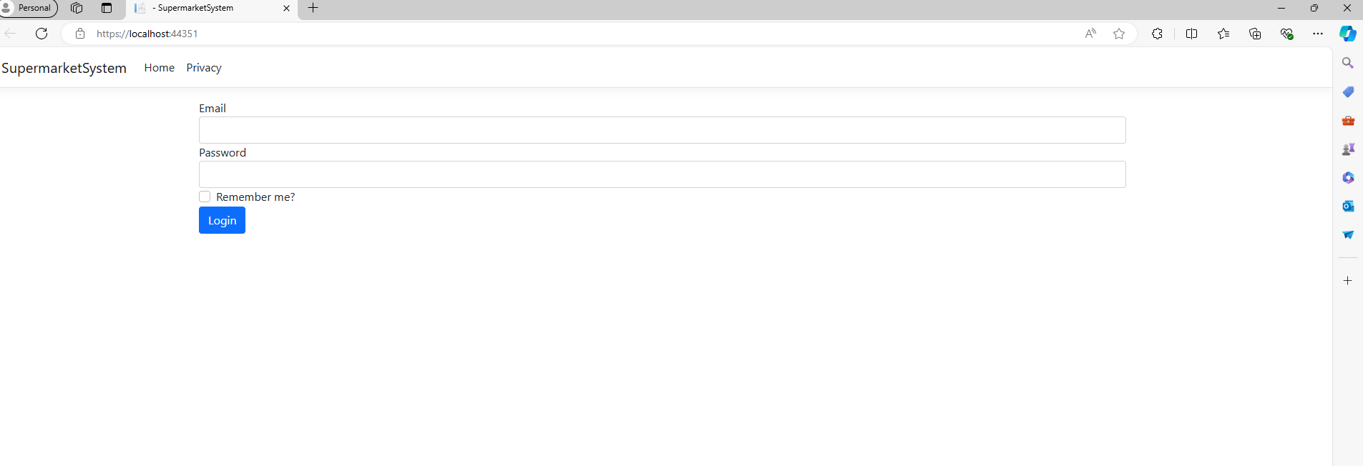
Demonstration

Slide 5
THANK YOU

